Slide 1
British Airways
Web scrapping to gain company insights

Slide 2
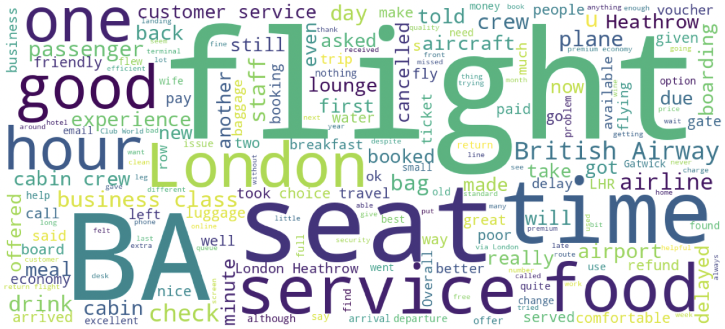
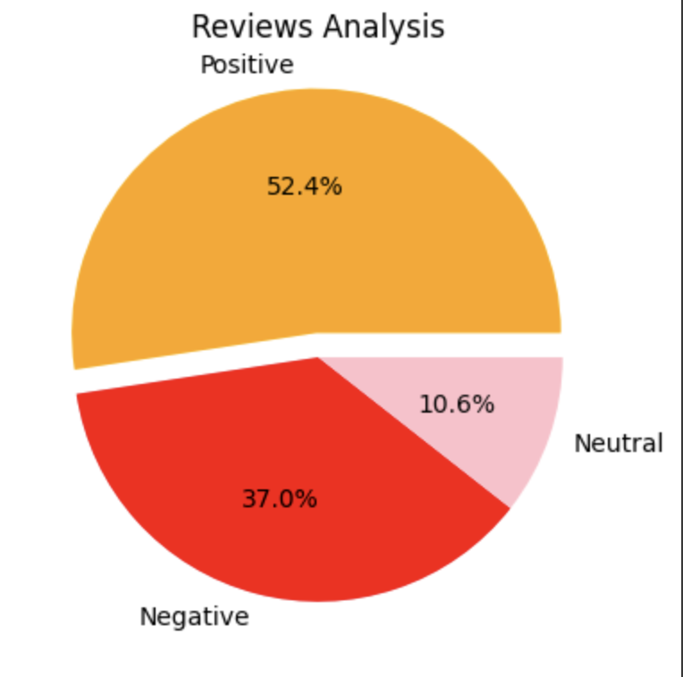
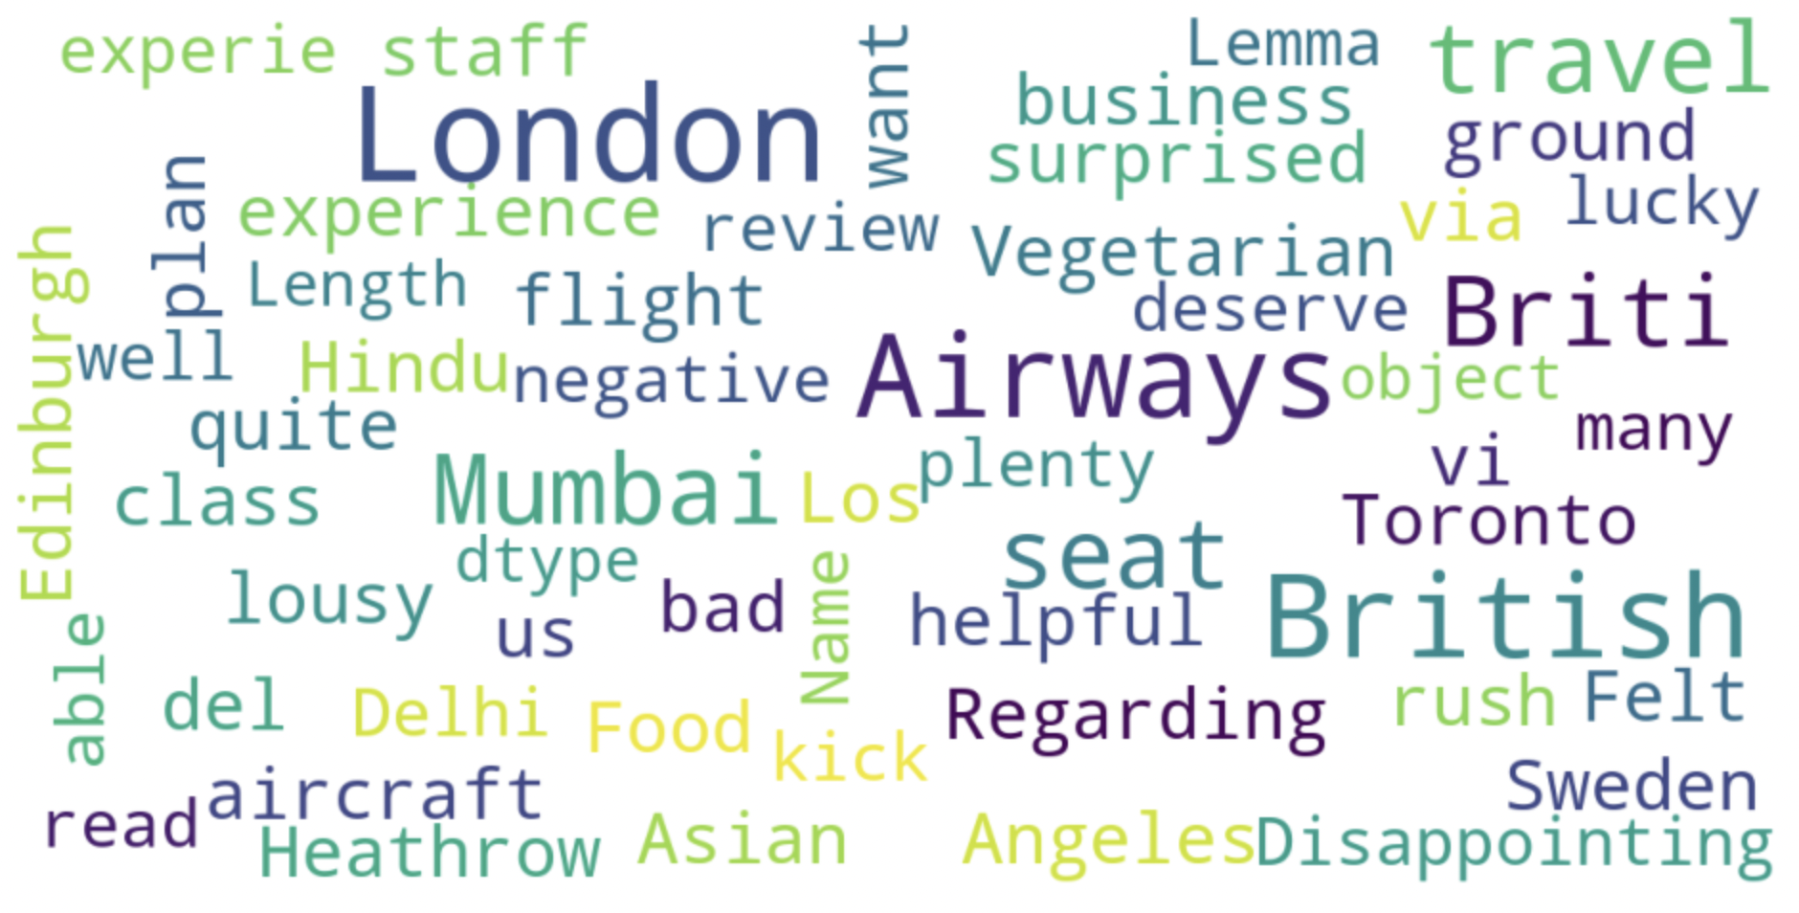
Insights from customer reviews
Positive 524 Negative 370 Neutral 106
we can see the key of topics in customer review are flight, seat , service and time. showing that people are actively talking about their experience on the plane and the staff.
Minimal selection of food items for purchase.
Long delay time
Some passengers are disappointed

